Slide 1
Argumentation 1 CSCM23 Trust, Understanding, and Negotiation
Dr. Adam Wyner
School of Law and Department of Computer Science
Swansea University, Swansea, United Kingdom

Slide 2
Plan
Basic notions of argumentation
NLP and argumentation
Computational models of argumentation
Argument schemes
Preferences and proof standards
Formalisation

Slide 3
What is an argument?
Reasoning from one (or more) assumption(s) and a rule to a conclusion.
Modus Ponens:
P
P -> Q
Therefore, Q
We can say that Modus Ponens is an argument scheme. We could refer to an instance of it as an argument A and that it argues for the conclusion Q.

Slide 4
‘Classic’ Logics
Inference in Propositional and Predicate Logic is
Monotonic - inferences once drawn cannot be withdrawn in light of new information
Inference rules are strict (not non-monotonic or defeasible); if the antecedents are true, the consequent must be true as well; rules are not removed.

Slide 5
Problems with Rules in Legal and Commonsense Reasoning
Inferences can change once information is added, e.g. new evidence and source material change a legal argument or new legislation.
Rules can become invalid, but not removed.
Rules are usually defeasible, that is, they hold in “normative” circumstances.
What the rules apply to might be arguable – mobile home wrt drug search and seizure.
Rules can have exceptions.
Arguments (e.g. court cases) may be contradictory (pro and con).
Claims (e.g. in court) need not be ‘true’, but only satisfy a proof standard.
Two or more rules may both apply and conflict, but perhaps resolved with rule priorities, e.g. lex superior.
Notes:
Examples of each would be good.

Slide 6
Argument NLP

Slide 7
Outline
Problem.
Pragmatic goal – extract argument elements.
Approach:
flexible, interactive, incremental, modular, semi-automatic information extraction using
semantic annotations that are relative to
argumentation schemes and that support
semantic queries.
Examples

Slide 8
Corpora - Where Arguments Appear
Consumer websites.
Law: policy (policy-making, voting, legislation), Supreme Court transcripts, case based reasoning, regulations.
BBC's Have Your Say and Moral Maze.
Medical diagnosis.
Making plans.
Debatepedia, Wikipedia, meeting annotations
Social media: web-forums, Twitter, Facebook, ....

Slide 9

Argument Fragment for a Camera

Slide 10
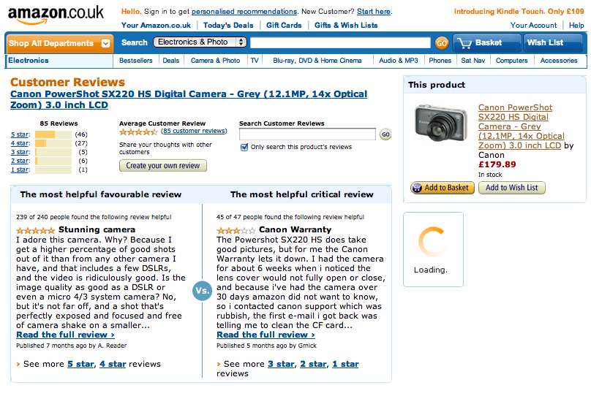
Pro and Con

Slide 11
Comments on Comments
Notes:
Why is opinion or sentiment analysis **not** sufficient? Because:
It provides no explanation or justification for the opinion, broadly construed.
We can count the numbers of participants who hold an opinion, but one well-made 'counter-argument' may lead individuals to retract their opinion.
Knowledge in the text is implicitly structured and many-layered. How can we extract that structured information?

Slide 12
LIBER Response to Copyright Consultation
- Question 9. Should the law be clarified with respect to whether the scanning of works held in libraries for the purpose of making their content searchable on the Internet goes beyond the scope of current exceptions to copyright?
- Yes.
- Not all the material digitised by publishers is scanned with OCR (Optical Character Recognition) with the purpose of making the resulting content searchable. If the rights holders will not do this, libraries should be able to offer this service. It would have a transformative effect on research, learning and teaching by opening up a mass of content to users which can be searched using search engines. The interests of copyright holders will not be harmed, because the resulting output will act as marketing material for their materials.
Notes:
Why is opinion or sentiment analysis **not** sufficient? Because:
It provides no explanation or justification for the opinion, broadly construed.
We can count the numbers of participants who hold an opinion, but one well-made 'counter-argument' may lead individuals to retract their opinion.
Knowledge in the text is implicitly structured and many-layered. How can we extract that structured information?

Slide 13
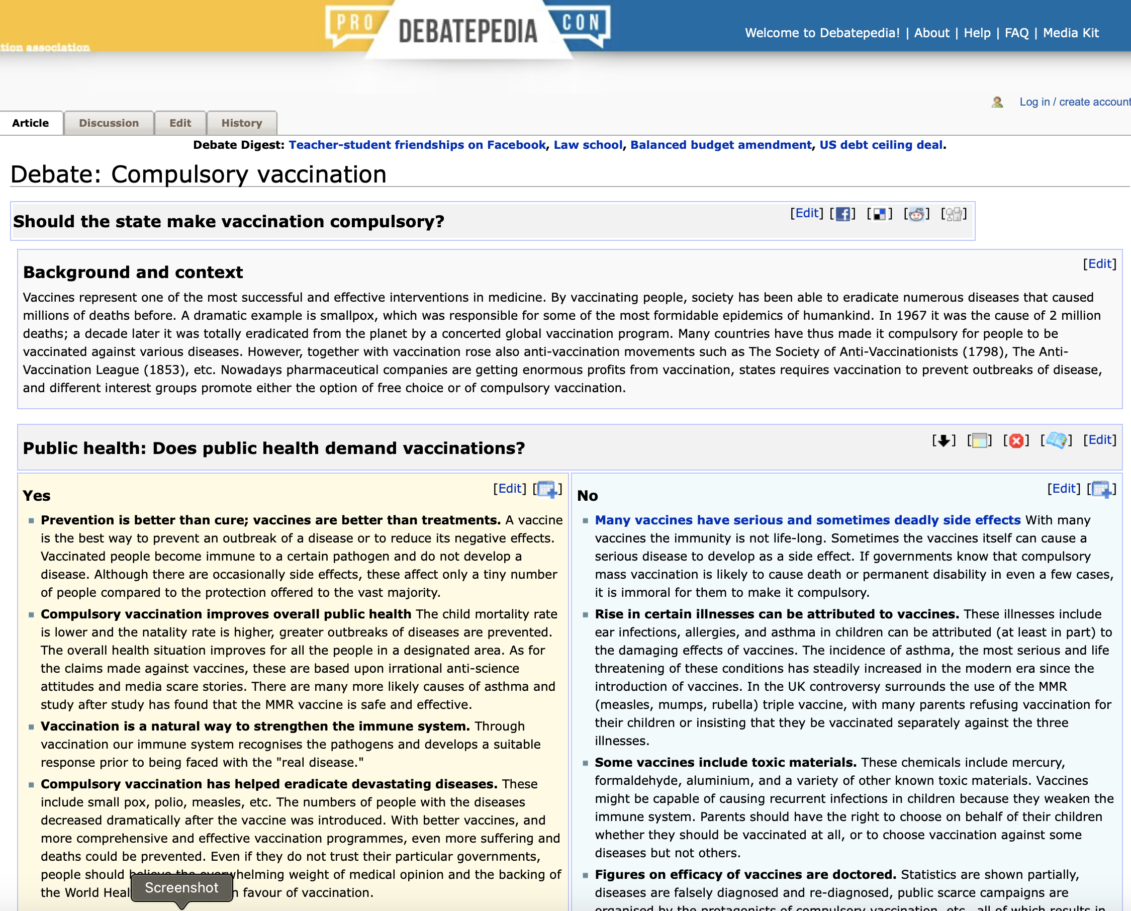
Debatepedia
Notes:
Why is opinion or sentiment analysis **not** sufficient? Because:
It provides no explanation or justification for the opinion, broadly construed.
We can count the numbers of participants who hold an opinion, but one well-made 'counter-argument' may lead individuals to retract their opinion.
Knowledge in the text is implicitly structured and many-layered. How can we extract that structured information?

Slide 14
A Problem with the Analysis of the Data
The arguments in these texts are:
fragmented and distributed across texts
conflicting/inconsistent statements
How to find, link, and summarise the arguments?
Contrast to arguments in a biomedical text or a Moral Maze discussion.
Notes:
Why is opinion or sentiment analysis **not** sufficient? Because:
It provides no explanation or justification for the opinion, broadly construed.
We can count the numbers of participants who hold an opinion, but one well-made 'counter-argument' may lead individuals to retract their opinion.
Knowledge in the text is implicitly structured and many-layered. How can we extract that structured information?

Slide 15
Current Practice and Proposal
For consumer websites – none. For policy-making – backroom analysis of Green Paper responses. Method? Transparent? Structure?
Proposal:
Provide a tool for expert analysts (in context and workflow) to extract relevant material, homogenise statements, and construct/reconstruct arguments, e.g. output structured policy statements derived from source.
Better understanding of what to look for and how.
Notes:
Why is opinion or sentiment analysis **not** sufficient? Because:
It provides no explanation or justification for the opinion, broadly construed.
We can count the numbers of participants who hold an opinion, but one well-made 'counter-argument' may lead individuals to retract their opinion.
Knowledge in the text is implicitly structured and many-layered. How can we extract that structured information?

Slide 16
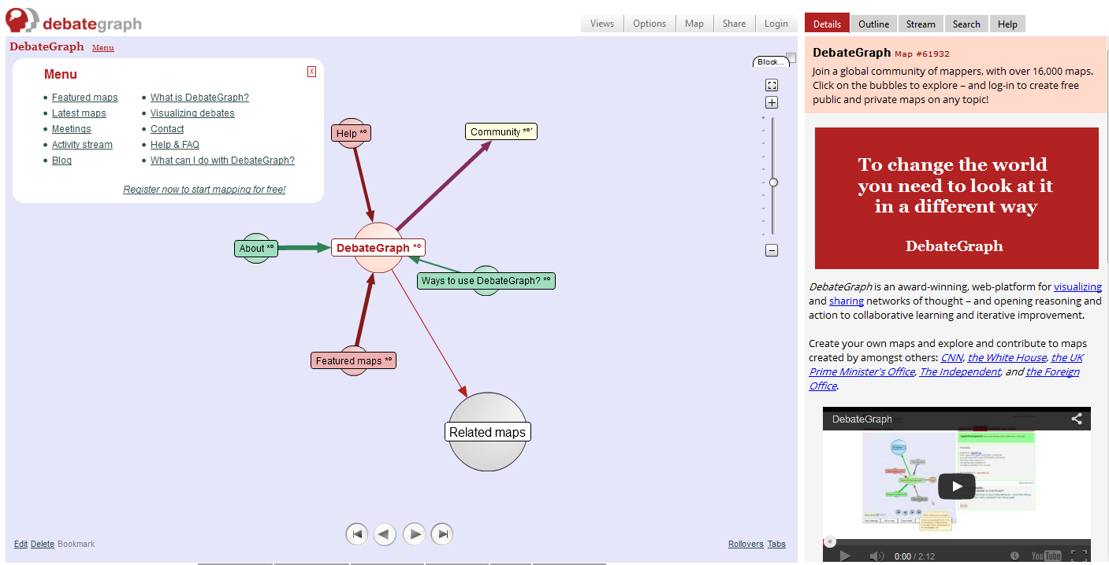
Argument modelling in DebateGraph

Slide 17
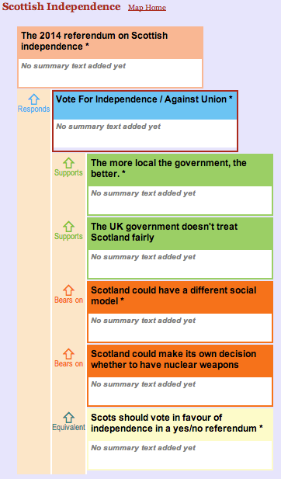
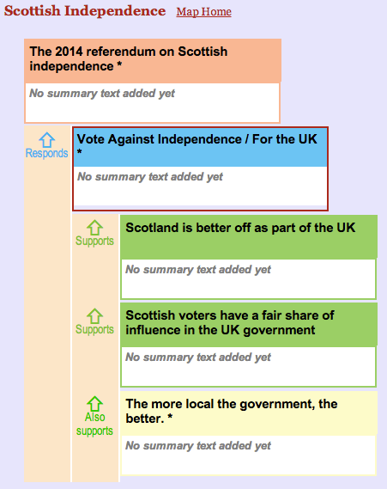
Arguments in debategraph.org
Current Method
- read text
- manually analyse
- manually enter text into tool
- manually annotate.
Problems
- slow, costly, error-prone, ad hoc, must search for 'place' of new additions, etc....

Slide 18
Organise with Argumentation Schemes
Patterns of defeasible reasoning:
Argument from position to know: reasoning about knowledge and individual's relation to it.
Argument from practical reasoning: reasoning about what to do.
Normalised reasoning language.
Wyner, Schneider, Atkinson, and Bench-Capon (2012).

Slide 19
Means: A Language Of Schemes
Finger-print the scheme.
characteristic terminology of the scheme.
generalise the terminology to cover variation.
distinguish "domain" from "generic" terminology.
semantic annotations as "conceptual covers" over terminology.
A scheme of linked schemes.
Complex, flexible queries over the annotations.
Use general tools to access many functionalities.

Slide 20
Locating the Problem and Engineering a Solution
The knowledge acquisition bottleneck from NL to some formal representation.
Source text
Knowledge base & argumentation schemes
Generated arguments (abstract or instantiated).

Slide 21
Decomposition for Argument Identification and Extraction
Create support tools for an argument analyst in identifying and extracting arguments from text.
Input the arguments to a knowledge base, e.g. DebateGraph
(www.debategraph.org)
Address:
linguistic variety (many-to-one sentence-proposition).
argument relations (premise, claim, exception, negation).
contrast or epistemic 'strength'.
discontinuity of arguments in textual source.
knowledge base dynamics.

Slide 22
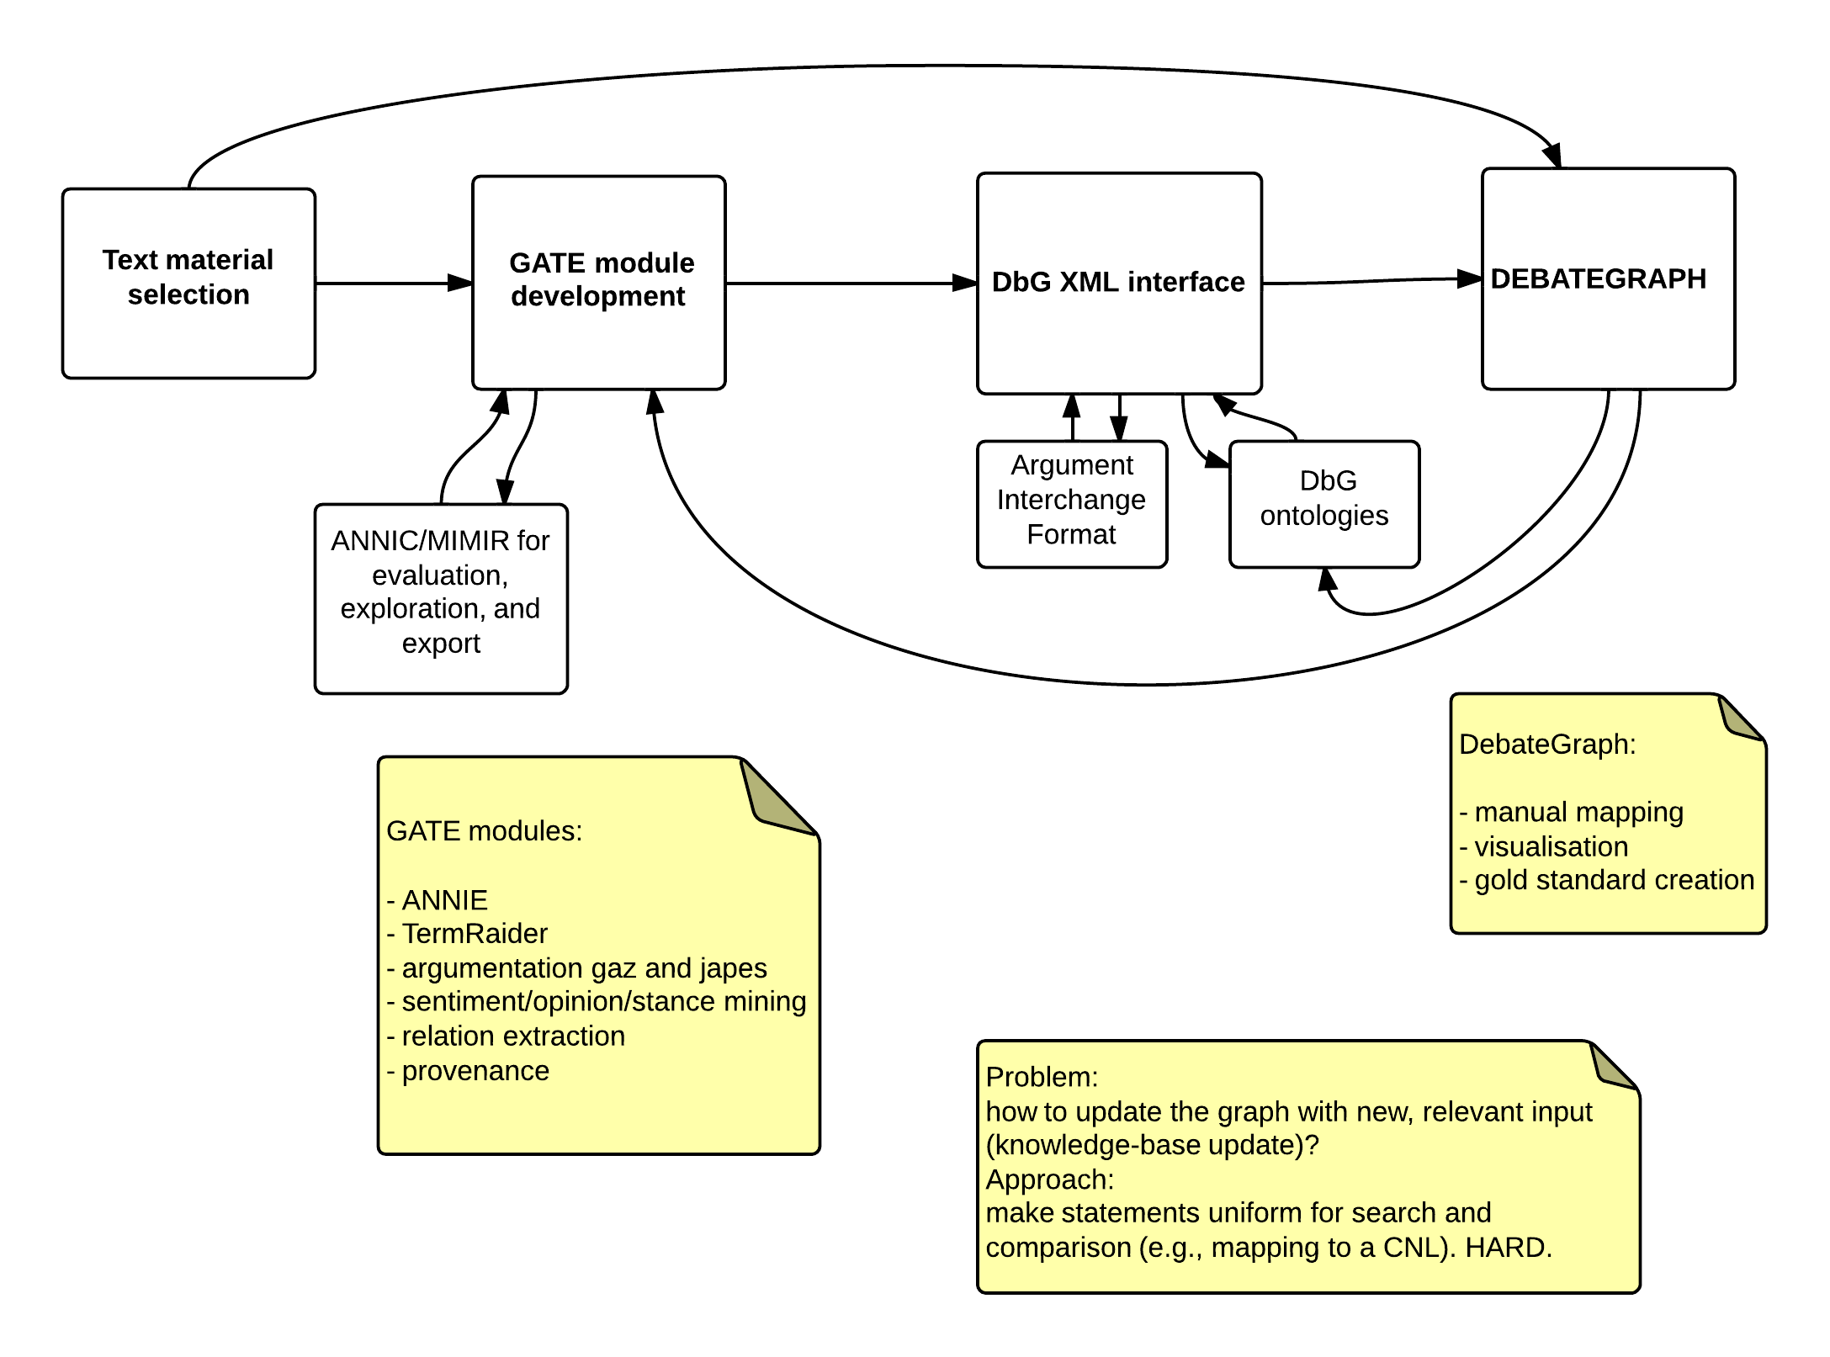
Information Extraction Pipeline
Pipeline by Peters
and Wyner (2014)

Slide 23
Annotate – Query – Extract
Annotate with respect to Argumentation Schemes.
characteristic terminology of the scheme.
generalise the terminology to cover variation.
distinguish "domain" from "generic" terminology.
Complex, flexible queries over the annotations.
Low level (atomic) and high level (molecular) constructions.
Interactive, semi-automatic.
Export XML to debategraph.

Slide 24
Annotating Text
Annotate for
Argument structure
Domain terminology
Contrariness
Sentiment
other....
epistemic terminology, e.g. likely, certainly, might, must....
propositional attitude verbs, e.g. believe, know,....
speech acts, e.g. report, stated, claimed, asserted,....
Notes:
Colors represent annotations in the text. We can then search for a large body of text

Slide 25
Find Argument Passages
Use:
Indicators of premise
after, as, because, for, since, when, ....
Indicators of conclusion
therefore, in conclusion, consequently, ....
Rhetorical connectives - elaboration, example, contrast.

Slide 26
Benefits
Modular analysis.
Transparent and explicit. Easy to modify and correct.
No need for parsed, pre-structured text.
Generic components apply anywhere.
No need for a gold standard.

Slide 27
Methodology
Low level automation, using high level structures as guides.
For example, no automatic search for scheme filling, grounding of variables, contrast identification.
The same bottom-up incremental approach I have been advocating all the time!

Slide 28
Consumer Argumentation Scheme
Typed variables in schemes as targets for extraction.
Premises:
Camera X has property P.
Property P promotes value V for agent A.
Conclusion:
Agent A should Action Camera X.

Slide 29
Analyst’s Goal: Instantiate
Premises:
The Canon SX220 has good video quality.
Good video quality promotes image quality for casual photographers.
Conclusion:
Casual photographers should buy the Canon SX220.

Slide 30
Annotating Text
Annotate text:
Scheme's typed variables = semantic annotations.
Atomic (context free) or complex annotations (contextualised).
Colour annotations = XML.
Search for and extract text by annotation.
Notes:
Colors represent annotations in the text. We can then search for a large body of text

Slide 31
Find Argument Passages
Use:
Indicators for Action e.g. should buy, should get,....
Indicators of premise
after, as, because, for, since, when, ....
Indicators of conclusion
therefore, in conclusion, consequently, ....

Slide 32
Rhetorical Terminology
Notes:
Screenshot from GATE, in which we have built components of a tool
Purple: conclusion
Orange: premise
Lots of ambiguity – different meanings of the words
*DOES* draw attention to relevant places.
Can turn on & off particular things that we’re looking for. Helps with the search problem.

Slide 33
Find What Is Being Discussed
Use domain terminology:
Has a flash
Number of megapixels
Scope of the zoom
Lens size
The warranty
Notes:
binary values (such as has a flash), properties with ranges (such as the number of megapixels, scope of the zoom, or lens size), and multi-slotted properties (e.g. the warranty).

Slide 34
Domain Terminology

Slide 35
Find Attacks Between Arguments
Use contrast terminology:
Indicators
but, except, not, never, no, ....
Contrasting sentiment
The flash worked poorly.
The flash worked flawlessly.

Slide 36
Sentiment Terminology
Notes:
Drawn from vast lists of terminology, given sentiment valence:
positive vs. negative +5 to 0 to -5
Can look for various levels or homogenize – this is homogenized

Slide 37
Domain properties, positive sentiment, premises

Slide 38
Query For Patterns
Create queries on the fly from the "language" of the annotations.
Extract strings that match the query.
Use the results to identify useful, complex queries.
Discontinuities.

Slide 39
An Argument To Buy The Camera
Premises:
The pictures are perfectly exposed.
The pictures are well-focused.
No camera shake.
Good video quality.
Each of these properties promotes image quality.
Conclusion:
(You, the reader,) should buy the CanonSX220.

Slide 40
An Argument NOT To Buy The Camera
Premises:
The colour is poor when using the flash.
The images are not crisp when using the flash.
The flash causes a shadow.
Each of these properties demotes image quality.
Conclusion:
(You, the reader,) should not buy the CanonSX220.

Slide 41


Contrary Propositions
The colour is poor when using the flash.
For good colour, use the colour setting, not the flash.
The images are not crisp when using the flash.
No need to use flash even in low light.
The flash causes a shadow.
There is a corrective video about the flash shadow.
Notes:
We have an argument for buying the camera, an argument for not buying the camera. They rebut each other.
We have attacks on the premises for “don’t buy the camera”. The argument for not buying the camera is defeated; the argument for buying the camera stands. So you should buy the camera.

Slide 42
Input to Argument Evaluators
Preferred extension:
{a, c, d, h, i, k}

Slide 43
Additions
Verb classes, e.g. propositional attitudes/opinion terms.
Fine-grained domain terminology.
Adjectival and noun classes for sentiment/opinion.
Ontologies.
Terminology for contexts, for user classes....

Slide 44
Argument Exploration
Flexible, interactive, incremental, modular, semi-automatic information extraction.
Identify and extract scheme information in and from across text. Explore how schemes appear in text.
Discontinuity/fragmentation by semantic search within sentences and across texts.
Interconnect relevant, related portions of schemes from extracted information.
Construct an argumentation graph for reasoning with inconsistency.

Slide 45

Different From
Not statistical NLP/Machine learning, though could use some aspects. Want to explain results, (manually) learn from error, and modify to suit (easy with lists and rules).
Can be used to develop a gold standard corpora.
No fixed syntactic or semantic structures.

Slide 46
Relates to....
Scheme/template filling for opinion and event mining.
Issues of discontinuity and coherence.
Structured argumentation.
Abstract argument evaluation.
Entailment graphs.

Slide 47
Solution: Computational Models of Argument
In abstract argumentation
Arguments are atomic and in ‘attack’ relations
The ‘semantics’ provide subsets of arguments, ‘extensions’, which are arguments that are accepted together
In instantiated argumentation
There are incomplete or inconsistent knowledge bases
There may be argumentation schemes (human reasoning patterns)
There may be proof standards (degree to which something is accepted) and priorities amongst rules.
Re-present as abstract argumentation to reason with inconsistency.

Slide 48
Argumentation Frameworks – Abstract
Dungian Abstract Argumentation
An approach to reasoning with inconsistent data, e.g. where p and not-p cannot both obtain.
Arguments are abstract ‘nodes’ in a graph and arcs between nodes represent ’defeat’.
An argumentation framework is defined as a set of nodes and arcs.
The ‘semantics’ calculates alternative ‘consistent’ extensions of an argumentation framework, which are sets of arguments where no argument in the set attacks another argument in the set. There is much more....

Slide 49
Argument Frameworks – Instantiated
Instantiated Argumentation (e.g. ASPIC+ and there are others)
Arguments are formed from a knowledge base of propositions and rules.
Arguments have internal structure with assumptions, a rule, and a conclusion.
Rules can be strict (or sometimes defeasible).
Contradictory propositions establish ‘attack/defeat’ relations between arguments.
Rule application (in some approaches) can be attacked.
Abstract over the internal structure of the arguments, then reason as in Abstract Argumentation.
Start with instantiated, then go to abstract
Get extensions and extract conclusions

Slide 50
Attacks: Rebuttal, Undermining, and Undercutting
Arguments A1 and A2
Rebuttals:
A1 and A2 rebut when their conclusions are contradictory
The conflict between the rebuttals is resolved by weighing the arguments and applying proof standards (see these later)
Undermining:
A1 undermines A2 when the conclusion of A1 contradicts a premise of A2
Undercutting:
A1 undercuts A2 when A1 attacks the applicability of the rule of A2
Ways of undercutting with preferences amongst rules

Slide 51
We should lower taxes
Lower taxes increase productivity
Increased productivity is good
Example of a political debate.
(Prakken)

Slide 52
We should lower taxes
We should not lower taxes
Lower taxes increase productivity
Increased productivity is good
Lower taxes increase inequality
Increased inequality is bad
Attack on conclusion (rebuttal).
Problem here is that in classical logic, we cannot reason with inconsistency.
Yet, this is very common in human communication and knowledge bases.
How to represent and reason in the face of inconsistency?
(Prakken)

Slide 53
We should lower taxes
We should not lower taxes
Lower taxes increase productivity
Increased productivity is good
Lower taxes increase inequality
Increased inequality is bad
Lower taxes do not increase productivity
Attack on premise () …
USA lowered taxes but productivity decreased
(Prakken)

Slide 54
We should lower taxes
We should not lower taxes
Lower taxes increase productivity
Increased productivity is good
Lower taxes increase inequality
Increased inequality is bad
Prof. P says that …
Lower taxes do not increase productivity
… often becomes attack on intermediate conclusion
USA lowered taxes but productivity decreased
(Prakken)

Slide 55
We should lower taxes
We should not lower taxes
Lower taxes increase productivity
Increased productivity is good
Lower taxes increase inequality
Increased inequality is bad
Prof. P says that …
Prof. P is not objective
Lower taxes do not increase productivity
Attack on inference
People with political ambitions are not objective
Prof. P has political ambitions
USA lowered taxes but productivity decreased
(Prakken)

Slide 56
We should lower taxes
We should not lower taxes
Lower taxes increase productivity
Increased productivity is good
Lower taxes increase inequality
Increased inequality is bad
Prof. P says that …
Prof. P is not objective
Lower taxes do not increase productivity
People with political ambitions are not objective
Prof. P has political ambitions
USA lowered taxes but productivity decreased
(Prakken)

Slide 57
We should lower taxes
We should not lower taxes
Lower taxes increase productivity
Increased productivity is good
Lower taxes increase inequality
Increased inequality is bad
Prof. P says that …
Prof. P is not objective
Lower taxes do not increase productivity
Increased inequality is good
People with political ambitions are not objective
Prof. P has political ambitions
USA lowered taxes but productivity decreased
Increased inequality stimulates competition
Competition is good
Indirect defence
(Prakken)

Slide 58
We should lower taxes
We should not lower taxes
A
D
Lower taxes increase productivity
Increased productivity is good
Lower taxes increase inequality
Increased inequality is bad
construct
abstract
arguments;
maintain
attack
relations
Prof. P says that …
Prof. P is not objective
Lower taxes do not increase productivity
Increased inequality is good
E
People with political ambitions are not objective
Prof. P has political ambitions
USA lowered taxes but productivity decreased
Increased inequality stimulates competition
Competition is good
C
(Prakken)
B
Notes:
So far we have illustrated:
Arguments have structure: premises, a conclusion, and an inference (I will not tell you yet what inference rules licence the inference)
So arguments can be attacked in three ways.
We can resolve attacks on the basis of our preference, to obtain defeat relations
Arguments can be complex (so premise attack often is attack on subconclusions)
But what we have not yet seen is how inferences can be drawn from all this. Now Dung’s beautiful insight was that inference can be studied by fully abstracting from the structure of arguments and the nature of defeat.

Slide 59

Removes the representation of
logical inconsistency.
Reasons over a graph of nodes and arcs.
Produces ‘extensions’ – those nodes that
are ‘coherent’ (can hold together).
A
B
C
D
E
P.M. Dung, On the acceptability of arguments and its fundamental role in nonmonotonic reasoning, logic programming, and n–person games.
Artificial Intelligence, 77:321–357, 1995.
(Prakken)
Notes:
58
Letters are NOT propositions!
Arrows are defeat relations.
A typical case of mutual defeat is equally strong arguments with contradictory conclusions.
Two typical cases of strict defeat:
- arguments with contradictory conclusions, one of which is stronger.
An ‘undercutter’, where the rule does not apply.
NB: We could leave B and E both white! ?? Meaning what, undecided? Meaning that if we want a grounded semantics, we minimize what is in?
Imagine a judge faced with a body of arguments.

Slide 60
1. An argument is In iff all arguments that attack it are Out.
2. An argument is Out iff some argument that attacks it is In.
Grounded semantics minimises In labelling
Preferred semantics maximises In labelling
Stable semantics labels all nodes
A
B
C
D
E
(Prakken)
Notes:
Question: what is the purpose of grounded v preferred? The smallest set of acceptable arguments v the largest set of acceptable arguments.

Slide 61
1. An argument is In iff all arguments that attack it are Out.
2. An argument is Out iff some argument that attacks it is In.
Grounded semantics minimises In labelling
Preferred semantics maximises In labelling
Stable semantics labels all nodes
A
B
Nothing attacks C.
C is in.
C
D
E

Slide 62
1. An argument is In iff all arguments that attack it are Out.
2. An argument is Out iff some argument that attacks it is In.
Grounded semantics minimises In labelling
Preferred semantics maximises In labelling
Stable semantics labels all nodes
A
B
C
D
E

Slide 63
1. An argument is In iff all arguments that attack it are Out.
2. An argument is Out iff some argument that attacks it is In.
Grounded semantics minimises In labelling
Preferred semantics maximises In labelling
Stable semantics labels all nodes
A
B
Two choices here.
C
D
E

Slide 64
1. An argument is In iff all arguments that attack it are Out.
2. An argument is Out iff some argument that attacks it is In.
Grounded semantics minimises In labelling
Preferred semantics maximises In labelling
Stable semantics labels all nodes
A
B
Preferred extension: {C, D, B}
C
D
E

Slide 65
1. An argument is In iff all arguments that attack it are Out.
2. An argument is Out iff some argument that attacks it is In.
Grounded semantics minimises In labelling
Preferred semantics maximises In labelling
Stable semantics labels all nodes
A
B
Preferred extension: {C, D, E}
C
D
E

Slide 66
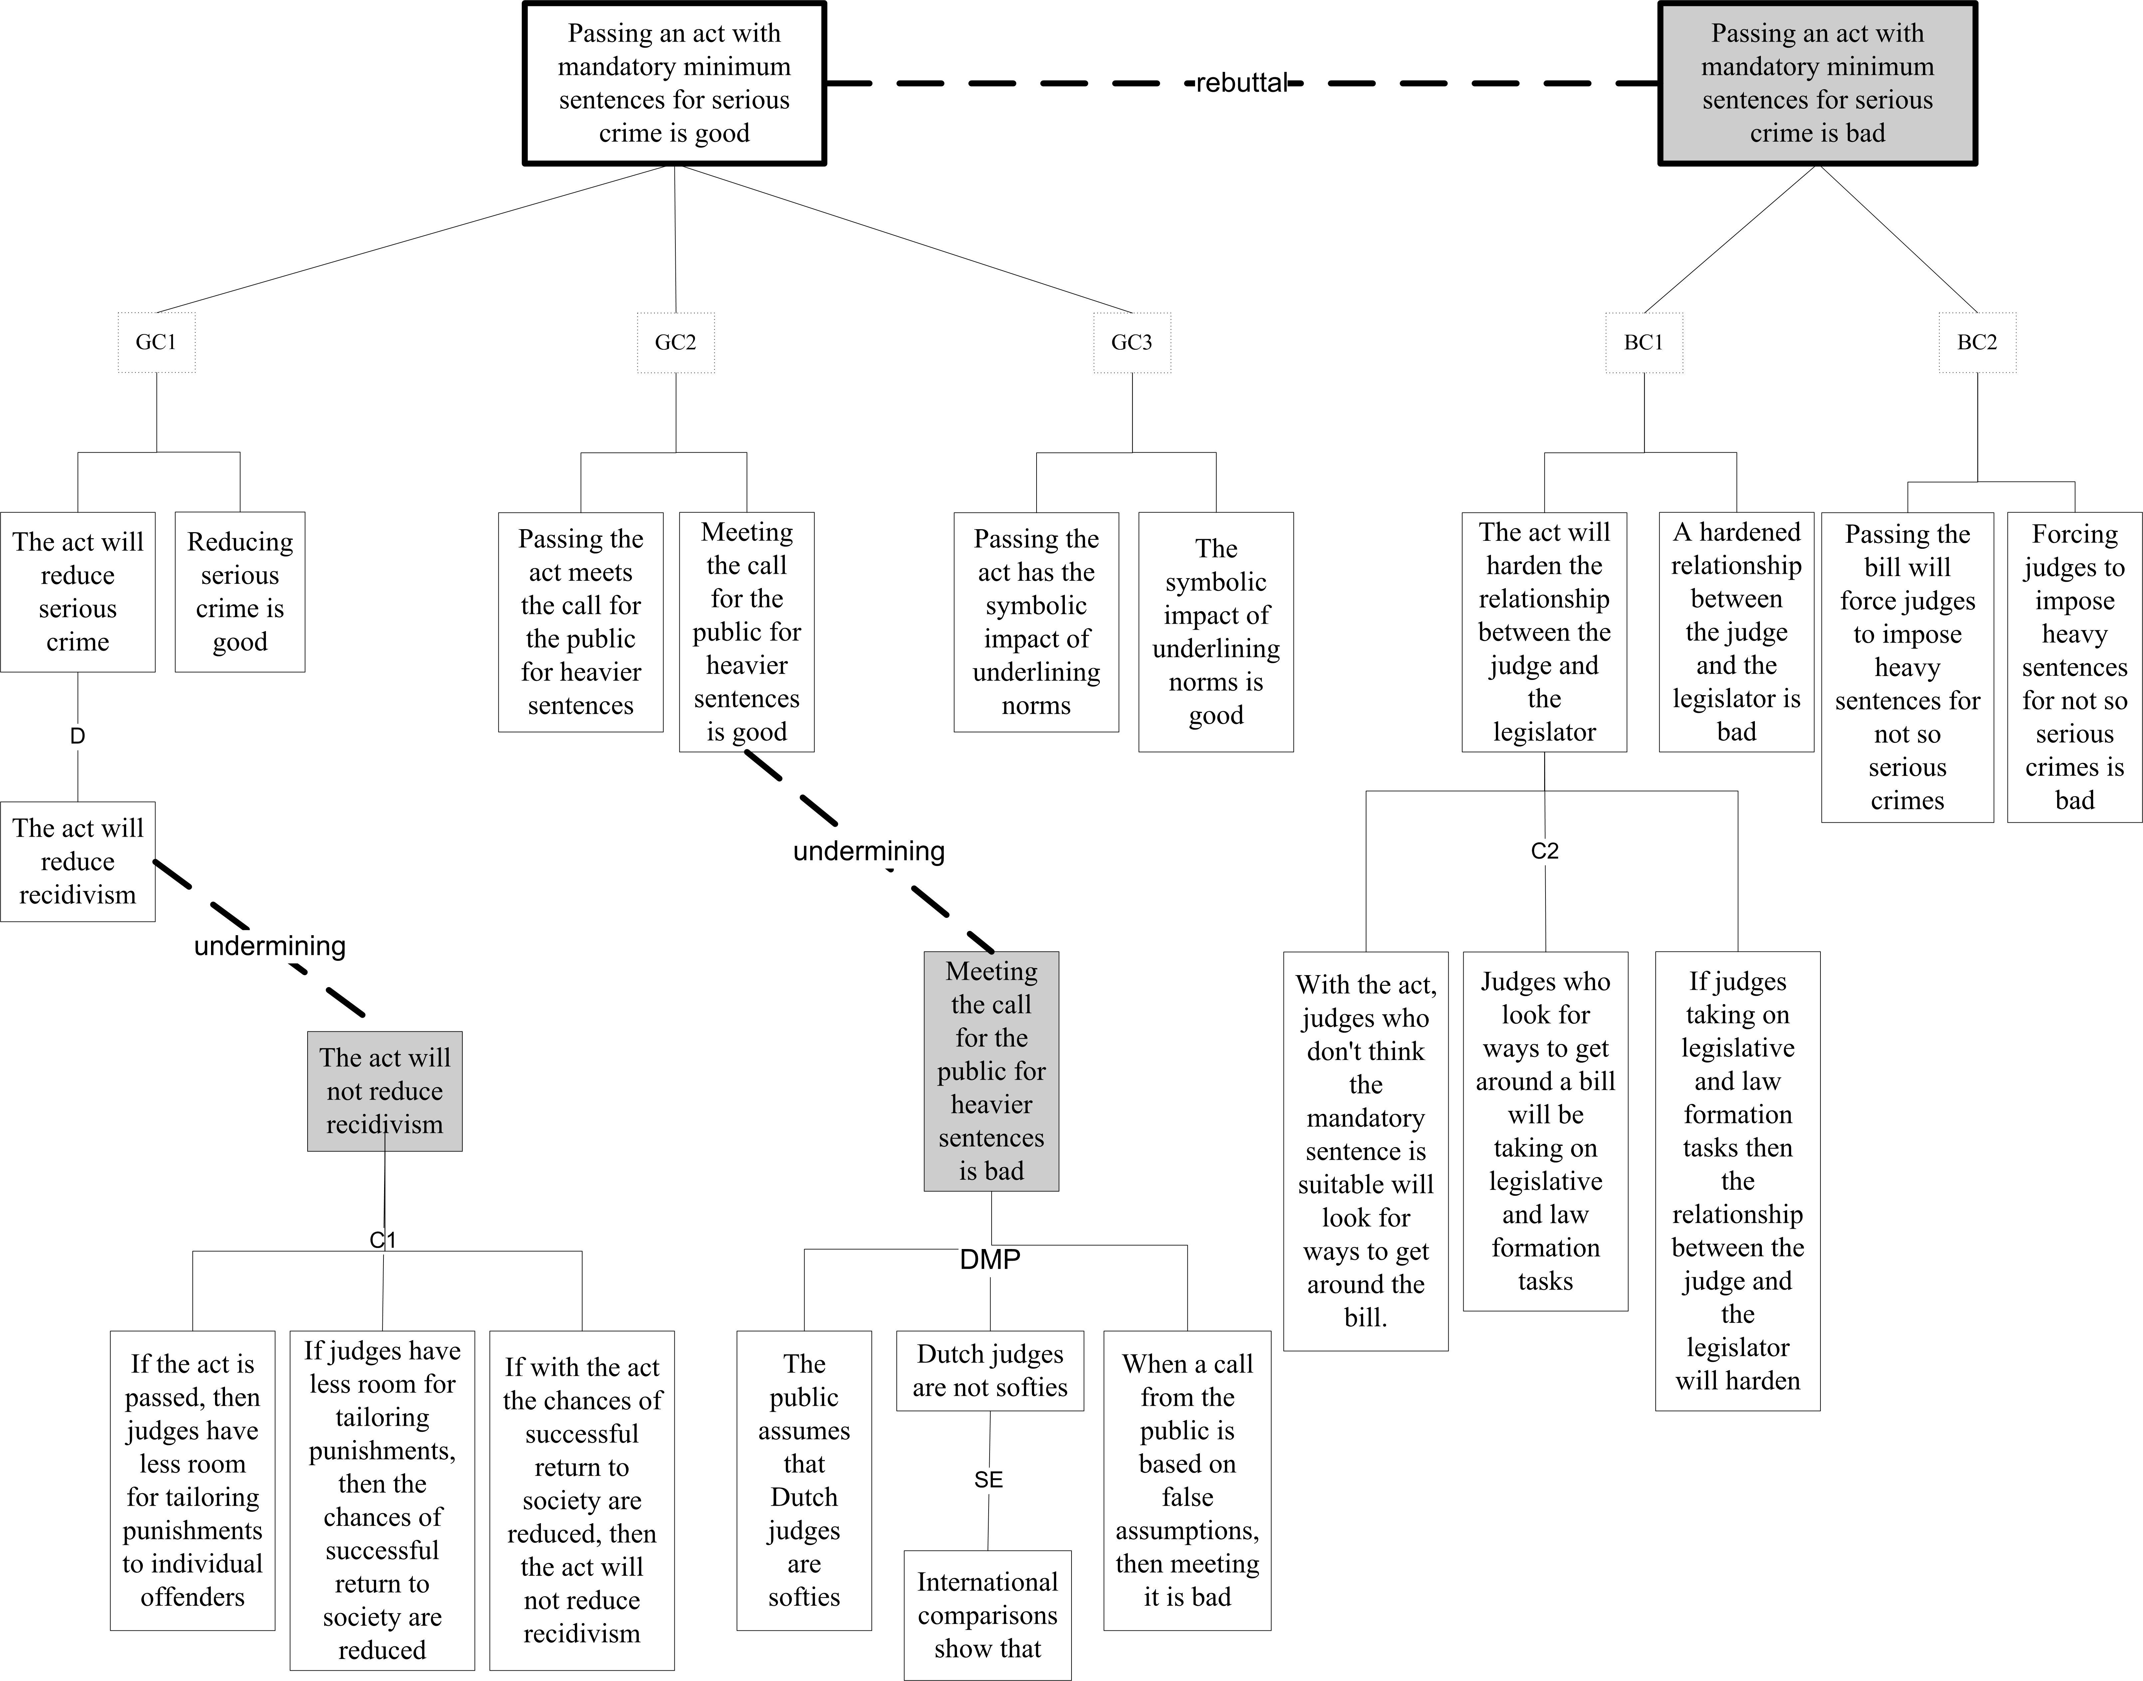
H. Prakken, Formalising a legal opinion on a legislative proposal in the ASPIC+ framework.
Proc. JURIX 2012
Notes:
This is a visualisation of Nico Kwakman’s legal opinion on the legislative proposal to have mandatory minimum sentences for recidivism in case of serious crimes.
This figure does not explicitly show multiple-consequences versions of the schemes from good and bad consequences. Instead, it only shows three applications of the single-good-consequence version of the scheme and two applications of the single-bad-consequence version of the scheme. The next slide, which contains the Dung graph of this example (again with various subarguments and all premise arguments left out), displays all combinations.
Why all the attacks on clusters of arguments, which seem redundant? Is this some notion of clustering arguments?
The solid lines are strict while the dashed lines are defeasible?
In the grounded labelling, the mutual attacks are left out, and only what is unattacked is in.
Why is the arrow one way from C1 to P1?
Why is the arrow dashes from DMP to P2?

Slide 67
Argument schemes
Argument schemes are defeasible inference rules
Defeasible Modus Ponens is an argumentation scheme
P
P => Q
Therefore, Q
Critical questions are pointers to counterarguments
Some point to undermining attacks
Some point to rebutting attacks
Some point to undercutting attacks
If the answer to a critical question is positive, then the argument is attacked; if there is no counter to the positive answer, then the argument is defeated.

Slide 68
Argument schemes – abstraction
Recall that we can abstract over arguments to have abstract nodes.
So too with argument schemes.

Slide 69
Argument schemes – application of legislation
Premise: There is a rule R1 with conditions A, B, C, …, that presumptively implies conclusion Z.
Premise: In the current case, the conditions of A, B, C,… are fulfilled.
Conclusion: Z presumptively can be drawn.
Does some exception to R1 apply?
Is some assumption to R1 not met?
Is R1 a valid legal rule?
Does some rule excluding R1 apply in this case?
Does some conflicting rule of higher priority that R1 apply in this instance?

Slide 70
Argument schemes – expert opinion
Premise 1: E is an expert in domain D.
Premise 2 : E asserts that A is known to be true.
Premise 3 : A is within D.
Premise 4: 1 and 2 and 3 presumptively imply A.
Conclusion: A may presumptively be taken to be true.
How credible is E as an expert source?
Is E an expert in domain D?
Is E reliable as a source?
Is A consistent with what other experts assert?
Is E’s assertion based on evidence?

Slide 71
Other legal argument schemes
Concepts (ontologies)
Reasoning from precedent cases
Evidence and testimony
Legal principles (example)
Ethical principles
Policy (relative to the purpose and values)
(Walton and Gordon)

Slide 72
Rule preferences
Abstract R1 > R2
Legal preference rules – reasons to accept one rule over another. Have an interpretive flavour
Lex Specialis – a legal rule that a more specific rule trumps a more general rule.
Lex Superiori – a legal rule backed by a higher authority trumps a rule backed by a lower authority (e.g. Federal law trumps state law).
Lex Posteriori – a later rule trumps an earlier rule.
Notes:
Ashley p144

Slide 73
Legal proof standards – in law
Scintilla of Evidence: a mere scintilla of evidence to justify a suspicion is not sufficient to support a finding upon which legal rights and obligations are based.
Preponderance of Evidence: the existence of contested fact is more probably, given the evidence, than not.
Beyond Reasonable Doubt: a proof so convincing that a reasonable person would not hesitate to act; a proof that leaves you firmly convinced….
Notes:
The next slide discusses proof standards in a computational theory of argumentation (Carneades). Notes that the correspondence is problematic.
Ashley 146

Slide 74
Legal Proof Standards – strength of an argument in Carneades
Scintilla of Evidence: supported by at least one defensible pro argument.
Preponderance of Evidence: strongest defensible pro argument outweighs the strongest defensible con argument, if there is one.
Dialectical Validity: supported by at least one defensible pro argument and none of the con arguments are defensible.
Beyond Reasonable Doubt: supported by at least one defensible pro argument, all of its pro arguments are defensible and none of the con arguments are defensible.
(Walton and Gordon)
Notes:
Next slide discusses the legal concepts of proof standards.

Slide 75
About Argumentation, there is much more to say
Formalisations
Probabilistic reasoning
Value-based reasoning
Evidential reasoning
Bridging between ‘human’ concepts of law and legal argument
Notes:
Formalisations
Probablistic reasoning (Ashley p147)
Value-based reasoning (Ashley p149)
Evidential reasoning (Ashley p160)
Bridging between ‘human’ concepts of law and legal argument (Ashley p164)

Slide 76
Basic Formalisations of Dungian Argumentation Framework

Slide 77
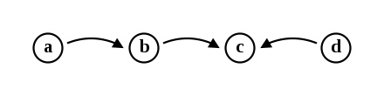
Abstract Argumentation Frameworks
Abstract argumentation frameworks, also called argumentation frameworks are defined formally as a pair:
A set of abstract elements called arguments, denoted A
A binary relation on A, called attack relation, denoted R
For instance, the argumentation system S = <A, R> with A = {a, b, c, d} and R= {(a, b),(b, c),(d, c)} contains four arguments (a, b, c and d) and three attacks (a attacks b,b attacks c, and d attacks c).

Slide 78
Dung (1995) Basic Notions
Dung (1995) defines some notions:
an argument a ∈ A is acceptable with respect to E ⊆ A if and only if E defends a, that is ∀b ∈ A such that (b, a) ∈ R, ∃c ∈ E such that (c, b) ∈ R,
a set of arguments E is conflict-free if there is no attack between its arguments, formally: ∀a, b ∈ E, (a, b) ∉ R,
a set of arguments E is admissible if and only if it is conflict-free and all its arguments are acceptable with respect to E.
Phan Minh Dung (1995). “On the acceptability of arguments and its fundamental rolein nonmonotonic reasoning, logic programming, and n–person game”. Artificial Intelligence. 77(2): 321–357

Slide 79
Various Semantics of Acceptance - Extensions
To decide if several arguments can be accepted together, Dung defines several semantics of acceptance that allow, given an argumentation system, sets of arguments (called extensions). For instance, given S = <A, R>
E is a complete extension of S only if it is an admissible set and every acceptable argument with respect to E belongs to E,
E is a preferred extension of S only if it is a maximal element (with respect to the set-theoretical inclusion) among the admissible sets with respect to S,
E is a stable extension of S only if it is a conflict-free set that attacks every argument that does not belong in E,
E is the (unique) grounded extension of S only if it is the smallest element(with respect to set inclusion) among the complete extensions of S.

Slide 80
Powerset of Arguments
It is also useful to consider the powerset of the arguments -
{a} {b} {c} {d}
{a, b} {a, c} {a, d} {b, c} {b, d} {c, d}
{a, b, c} {a, b, d} {a, c, d} {b, c, d}
{a, b, c, d}

Slide 81
Inclusions between Extensions
There exists some inclusions between the sets of extensions built with these semantics:
Every stable extension is preferred
Every preferred extension is complete
The grounded extension is complete
Some other semantics have been defined

Slide 82
Dialogue Types
Type of Dialogue | Initial Situation | Participant's Goal | Goal of Dialogue
Persuasion | Conflict of opinions | Persuade other party | Resolve or clarify issue
Inquiry | Need to have proof | Find an verify evidence | (Dis)Prove hypothesis
Discovery | Need to find an explanation of facts | Find and defend a suitable hypothesis | Choose the best hypothesis for testing
Negotiation | Conflict of interests | Get what you most want | Reasonable settlement both can live with
Information-seeking | Need information | Acquire or give information | Exchange information
Deliberation | Dilemma or practical choice | Co-ordinate goals and actions | Decide best available course of action
Eristic | Personal conflict | Verbally hit out at opponent | Reveal deeper basis of conflict

Slide 83
References
P.M. Dung, “On the acceptability of arguments and its fundamental role in nonmonotonic reasoning, logic programming, and n–person games”. Artificial Intelligence, 77:321–357, 1995
https://www.sciencedirect.com/science/article/pii/000437029400041X
Pietro Baroni, Martin Caminada, Massimiliano Giacomin, “An introduction to argumentation semantics”. Knowledge Eng. Review 26(4): 365-410, 2011
https://users.cs.cf.ac.uk/CaminadaM/publications/KER-BaroniCaminadaGiacomin.pdf
Youtube Tutorial about Online Visualisation of Argument
https://www.youtube.com/watch?v=L5pNo58IFJ0
http://www.arg-tech.org/index.php/ova/
Debatepedia – sample debate
http://www.debatepedia.org/en/index.php/Debate:_Ban_on_sale_of_violent_video_games_to_minors

